Slide 1
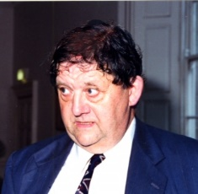
John Gabriel Byrne (1933 – 2016)

Slide 2
Thomas Brendan Byrne
(John Byrne’s father)
School of Engineering BAI Class of 1922-23

Slide 3
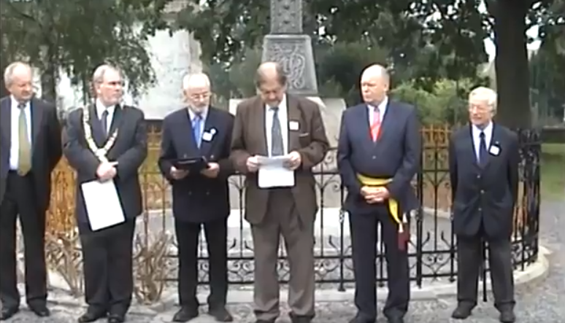
John Byrne speaking at the centenary of the unveiling of the celtic cross commemorating the part which the Irish Brigade played in the Battle of Fontenoy in 1745 at Fontenoy, Belgium in 2007

Slide 4
Gerald FitzGibbon, Victor Graham, John Byrne, William Wright, Doreen and Brendan Byrne (John’s parents) on the occasion of John’s election to Fellowship in 1969

Slide 5
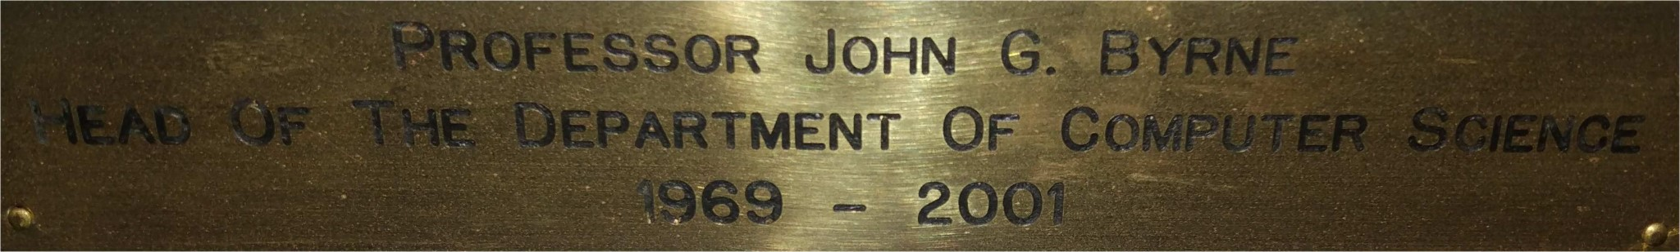

Slide 6
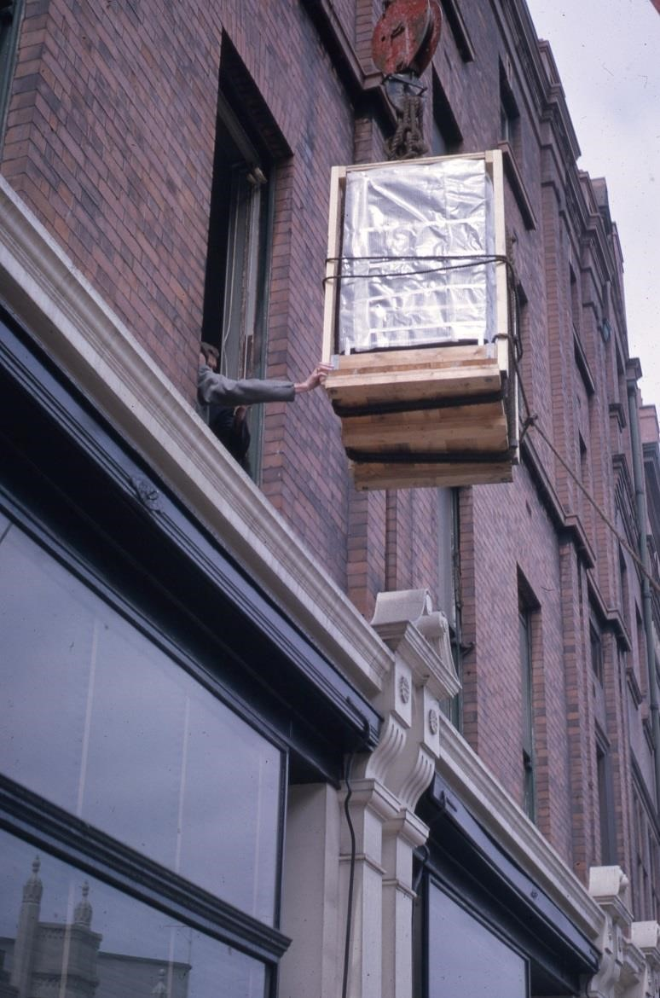
The IBM 1620, Trinity College’s first computer, being lifted in through the window of
21 Lincoln Place, June 1962

Slide 7
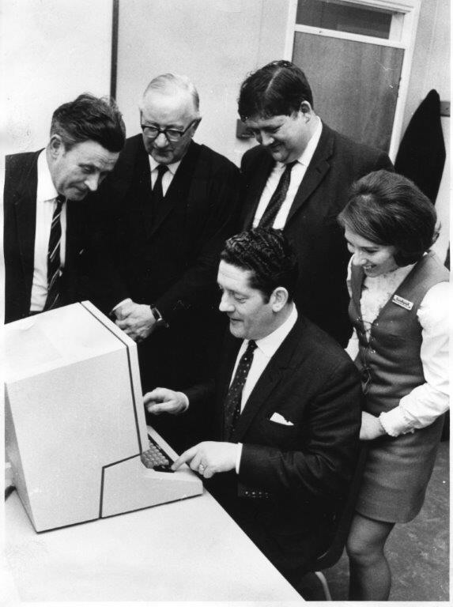
Prof William Wright, Provost A.J. McConnell, John Byrne, Rosemary Byrne and Brian Lenihan, T.D. at launch of IBM 360/44, 1969

Slide 9
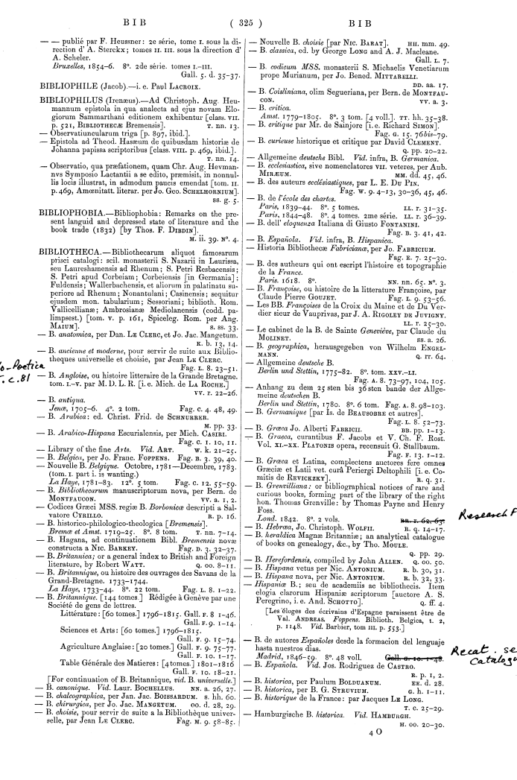
Sample page from the 1872 Printed Catalogue

Slide 10
“Imagine a large hall like a theatre, except that the circles and galleries go right round through the space usually occupied by the stage. The walls of this chamber are painted to form a map of the globe. The ceiling represents the north polar regions, England is in the gallery, the tropics in the upper circle, Australia on the dress circle and the antarctic in the pit…..

Slide 11
….A myriad of computers are at work upon the weather of the part of the map where each sits, but each computer attends only to one equation or part of an equation. The work of each region is coordinated by an official of higher rank. Numerous little “night signs” display the instantaneous values so that neighbouring computers can read them. Each number is thus displayed in three adjacent zones so as to maintain communication to the North and South on the map.”
[Richardson’s Fantasy of a Weather Forecast Factory, L. W. Richardson, Weather predication by digital process, Cambridge University Press, 1922.]

Slide 12
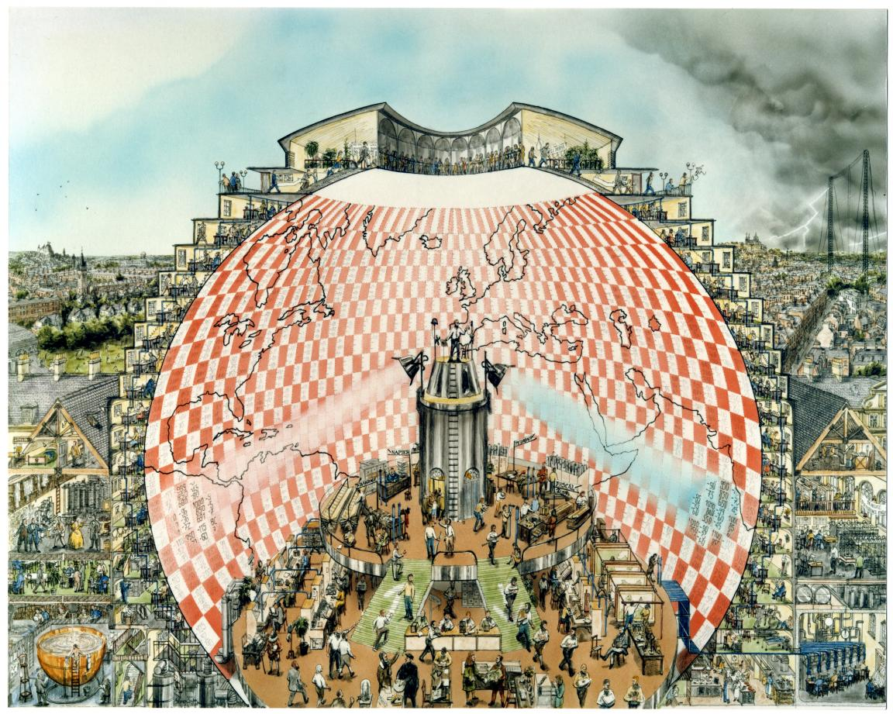
“Weather Forecasting Factory” by Stephen Conlin, 1986. Based on the description in Weather Prediction by Numerical Process, by L.F. Richardson, Cambridge University Press, 1922, and on advice from Prof. John Byrne, Trinity College Dublin.

Slide 13
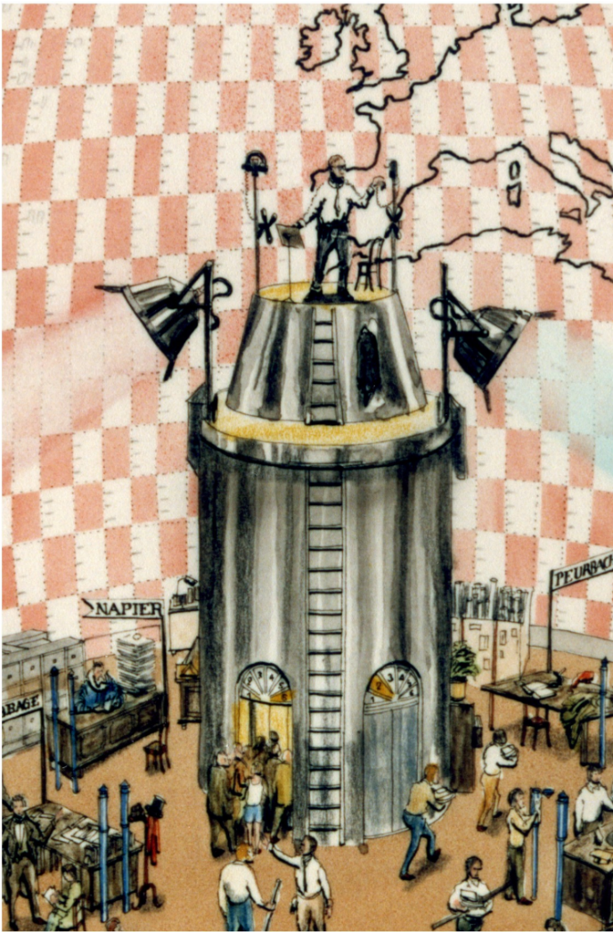
Director of Operations standing on central tower: Lewis F. Richardson

Slide 14
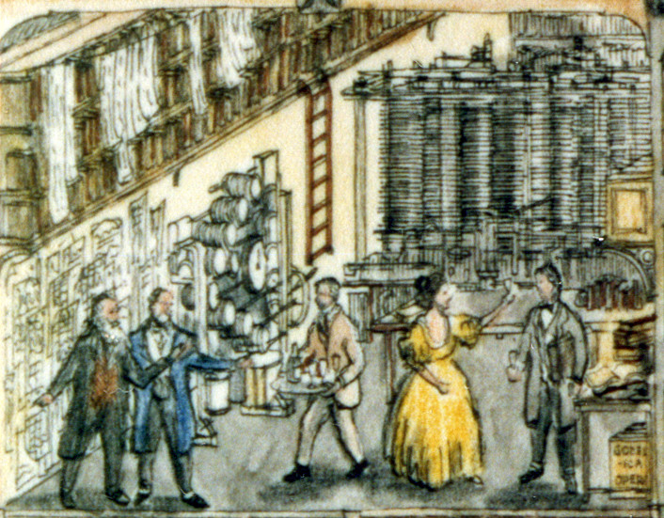
The Arithmetic Research Room. Left to right:
Lord Kelvin (1824-1907) and his brother James Thomson;
Percy Ludgate (1883-1922), Irish inventor of an Analytical Engine;
Ada Lovelace (1815-1852), daughter of Lord Byron and friend of Babbage;
George Boole (1815-1864), inventor of Boolean algebra

Slide 15
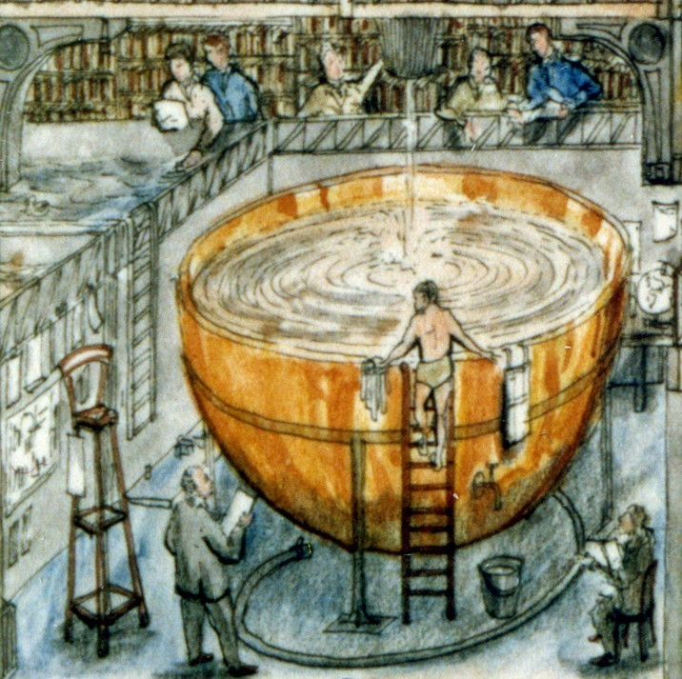
A large hemispheric bowl spinning on a turntable, for geophysical experiments. The figure standing below the tank is
Sir Geoffrey Taylor, George Boole’s grandson

Slide 16
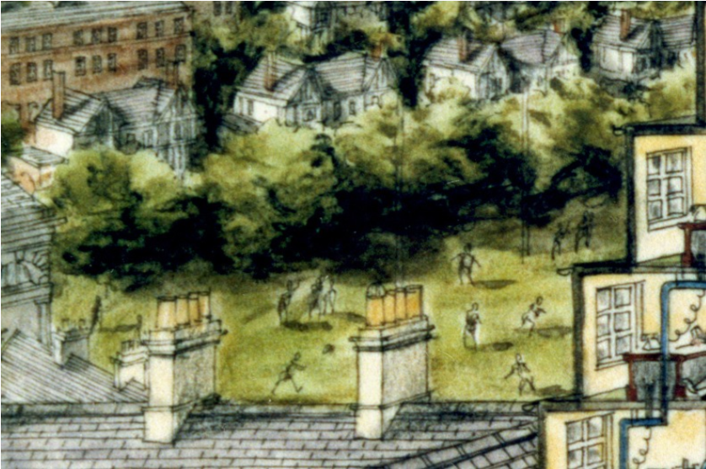
“Outside are playing fields, houses, mountains and lakes, for it was thought that those who compute the weather should breathe of it freely.”

