Slide 1
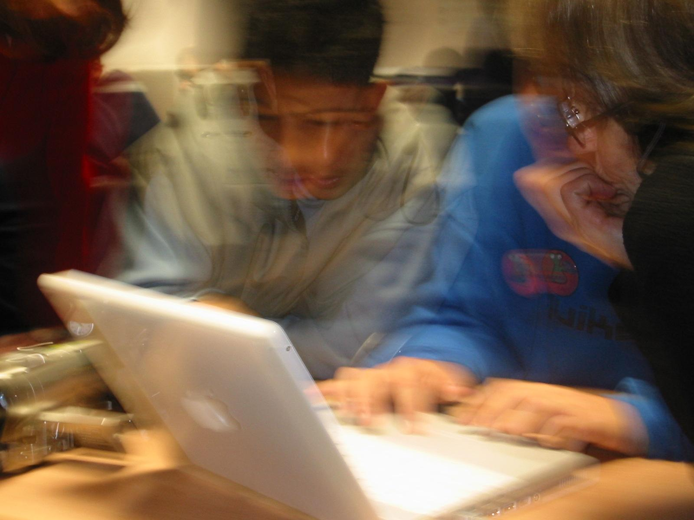
Setting the Scene
Getting it right this time…
Elizabeth Oldham

Slide 2
Introduction
We have structured our thinking for today round headings in CESI’s submission on the Coding Short Course in the Junior Cycle
Welcome, Why, How, Who, What (and questions)
I shall address – mainly – the first two…
Welcome
…with aspects of “what”
Why?
… and why now?
… and pose questions / raise issues
Others will flesh out what, how and who

Slide 3
Welcome … what?
CESI greatly welcomes the commitment to introduce Computer Science and the draft syllabus
However, we have been (almost) there before….

Slide 4
Guess who and when!
Minister for Education
“It is my firm intention that Computer Studies will be formally introduced into second-level curriculum as a separate subject by the school-year … at the latest”
Suggestions?
Welcome then too!
Answer
John Wilson, 1981, for 1983-84
Continuing
“[This will require] …
The development of appropriate syllabi
The provision of appropriate teacher training courses…”

Slide 5
So – what happened?

Slide 6
Moves had started – “Computer Studies Option” in Leaving Certificate Mathematics
Introduced in 1980
Interim scheme, awaiting full subject
Anyone here taught it? Until when?
Welcome as an interim measure – stand-alone subject preferred
Continued into the 2000s….
Officially discontinued only in 2013
Notes:
The arrangements continued in some form at least up to 2008-09 - see Circular 0006/2008
The Departmental certification for participation was officially discontinued in 2013 via Circular 0056/2013

Slide 7
What was included?
From Rules and Programme
Flexible…
School based?
Notes:
[Note foci – social aspect, structure, programming – flexibility re language; assessment school-based; 35 hrs, 10 programs]

Slide 8
Support provided
Departmental summer courses from 1982

Slide 9
The second stage: Computer Studies in the Junior Cycle
Welcome!
“The thing happens,” 1985
(Bernard Shaw, Back to Methuselah)
A free-standing subject
… though non-examinable in the Intermediate Certificate
Anyone here remember it? Taught it? Until when?
Departmental summer courses and notes
Support … into the 1990s
Faded out
Notes:
(a mistake…; see CESI DB 1991)

Slide 10
What was the rationale / focus?
From Rules and Programme

Slide 11
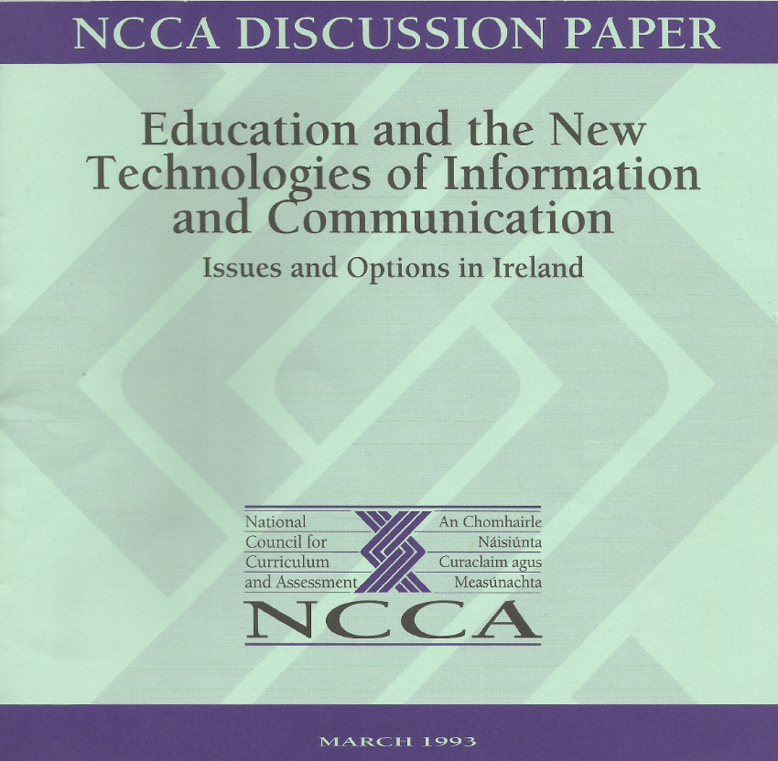
Anticipating the third stage….
Discussions
Two subjects (Computer Science and Computer Applications) for Leaving Certificate?
A CESI-inspired idea

Slide 12
NCCA policy work, 1993-1994
In context also of students’ “entitlement” to IT literacy at 15+
Discussions (e.g. at CESI conferences from 1993)
Would have been welcome…
Outcome – whole ICT area too important to be done in a hurry
No time then to do topic justice
The possibility of including a module in a reconfigured Applied Maths course was considered in 1994 …
… but the review of Applied Maths did not happen
Familiar…?

Slide 13
NCCA policy work, 2000-2004
Computer Science not recom-
mended
Two reports commissioned
First completed 2000 (not published)
Second published in 2004
“Difficulties and Dichotomies”
O’Doherty et al., 2004
Brief was about possibilities and implications, not recommendations
Very thorough analysis that highlighted the confusion between use of ICT in teaching and learning; subject matter distributed across the curriculum; a subject involving ICT / skills; and Computer Science
Saw problems rather than solutions?
Noted that groups consulted by the authors did not in general advance economic arguments
Notes:
For this story line, the starburst is a summary – not really fair to a very thorough report using a mixed-methods approach and consulting different groups.

Slide 14
Transition from “what happened” …
… to “why”

Slide 15
Why?
For Computer Studies in the 1980s, two kinds of “why” question
Why at that time? (Context)
For what purpose? (Aim)
And – why did the courses fade out?

Slide 16
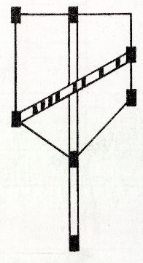
Context: why in the 1980s?
International interest from 1960s
The Department of Education ran summer courses in FORTRAN programming, 1971, 1972, 1973, 1974
Led to the foundation of CESI in 1973
CESI taking the baton (mid-1970s)
Visions for education
Supportive of all aspects of “computer education”, but focusing then mainly on
The introduction of Computer Studies to the curriculum
Providing CPD (CESI summer courses from 1975)
Developed as a cross between a subject association and a pressure group, cooperating with various bodies…

Slide 17
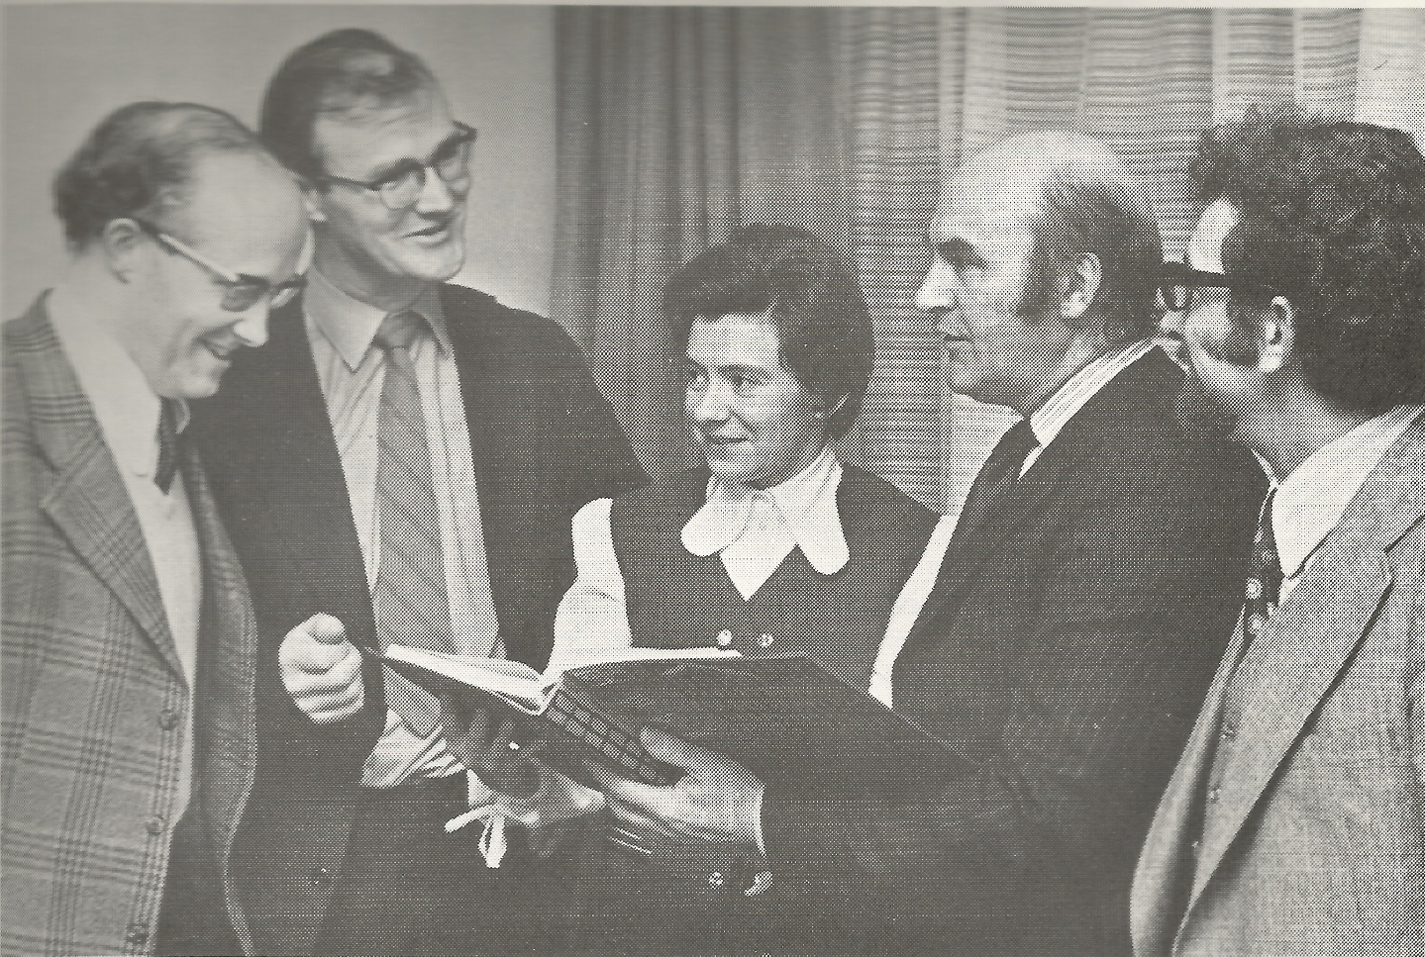
CESI as the go-to body for consultations on computer education…
E.g.: Diarmuid McCarthy (CESI Secretary), John Kelly (CESI Chair), Elizabeth Oldham (CESI), John Daly (ICL), Jim Walsh (CESI)

Slide 18
Why in the curriculum: aims / rationale?
CESI
Department also (?)
Two thrusts
Preparing students for living in the computer age / information society
Demystifying computers, aiming to obviate statements like “The computer made a mistake in my bill”
Developing problem solving / higher order thinking
Doing for all students what Latin and Maths had been supposed to do, but didn’t….
… Hence, not driven by economics but by benefiting the students

Slide 19
Where in the curriculum?
Applied Maths?
Considered in 1994 (see above) – but…
Mentioned in discussions between the Department and CESI, 1974 (by a Departmental voice)
Resurfaced in 1984, 1994 … and 2014 ...
No…
Leaving Certificate Maths?
Choice made for optional module in 1980
Mathematical aspects (emphasised by Department personnel)
An existing subject taken by (almost) all
Then, time to spare especially in Ordinary level Maths!!!
Inspector Con O’Keefe, recently asked “why,” said “Thinking”
A free-standing subject in Junior and / or Senior cycle?
Choice made for Junior cycle course in 1985
CESI had the subject-association seat on what was the last Departmental syllabus committee

Slide 20
What did not work?
Courses were quite typical of their time, but…
“Computer Science” aspects did not engage all students
In particular, view of programming as problem solving for all was optimistic, at least with the languages of the day
Human-computer interface was not as simple as later
Lack of official assessment was problematic
Other “computer” aspects more fun and easier
Games / adventure games
Computer as tool – via use of applications packages: ICT
The Internet, web, communications….
Notes:
… and those who DID like traditional programming didn’t always warm to declarative programming with PROLOG

Slide 21
So do it differently this time…
“Please believe us, we won’t make the same mistakes again…”??
“The time has come”!

Slide 22
Why again now?

Slide 23
Context and purpose
Context – international trend
Focus on computational thinking (Wing, 2006)
Clarification that there are [at least] three different areas: use of ICT in teaching and learning; a subject involving ICT / skills; and Computer Science (Bell, Andreae and Lambert, 2010)
Distinct, complementary, not “either / or”
Purpose
Computer Science for some?
Should not diminish opportunities for all to learn skills etc. …
Economic arguments – workers for the IT industry etc.
Now a dominating thread in public discourse
Educational arguments – problem solving etc. as before
Prominent thread in educational discourse
We hope!

Slide 24
Moving forward
Issues
Questions same as in years gone by, though answers may differ
Some new questions also?
See Digiteach article on the “Open Space” session at CESIcon 2017 (www.cesi.ie) …
… and outcome of today’s symposium!
Over to the other speakers for details of what, how, who and so forth….

