Slide 1
Backup with Snapshots

Slide 2
Snapshots Concept
Minimum Snapshot size: 1%
Alarm when snap size reach 80%
Up to 4 per volume
Writable and mountable
Used mainly for backup & restore
Other usages: DB duplication for
testing, boot images
New Write Block
Old Block
“Expose”
Original
Volume
IP SAN
Snapshot
Volume
9 am
Snapshot
Volume
8 am
Snapshot
Volume
7 am
Snapshot
Volume
6 am
“Rollback”
Method: Copy old on write

Slide 3
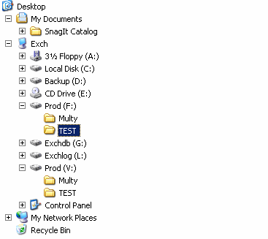
Restoring Directory from Snapshot
Copy directory

Slide 4
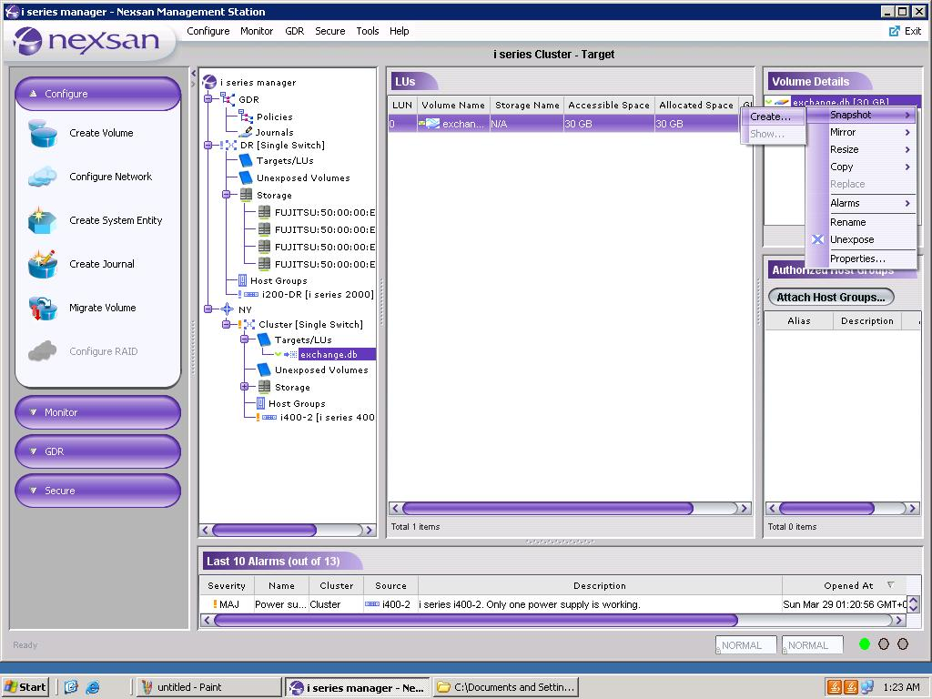
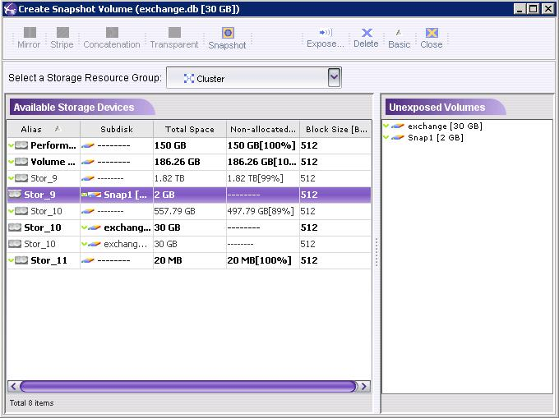
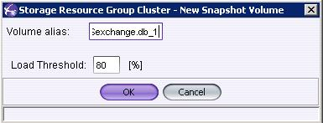
Create Snapshot

Slide 5
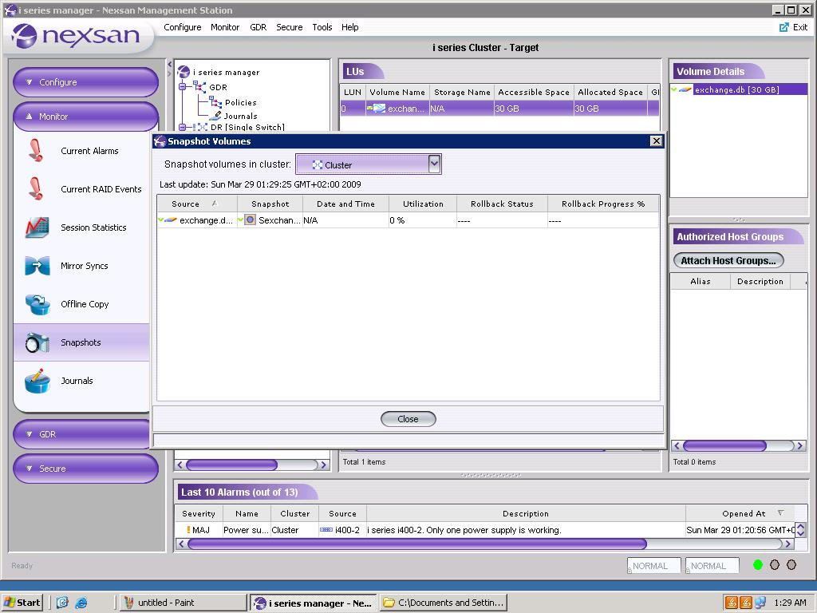
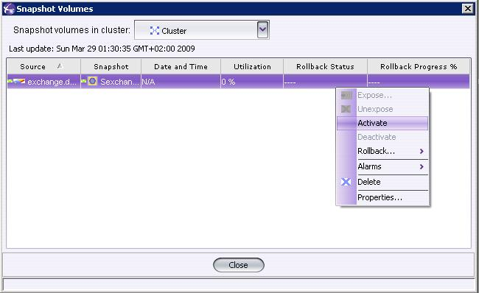
Activate Snapshot

Slide 6
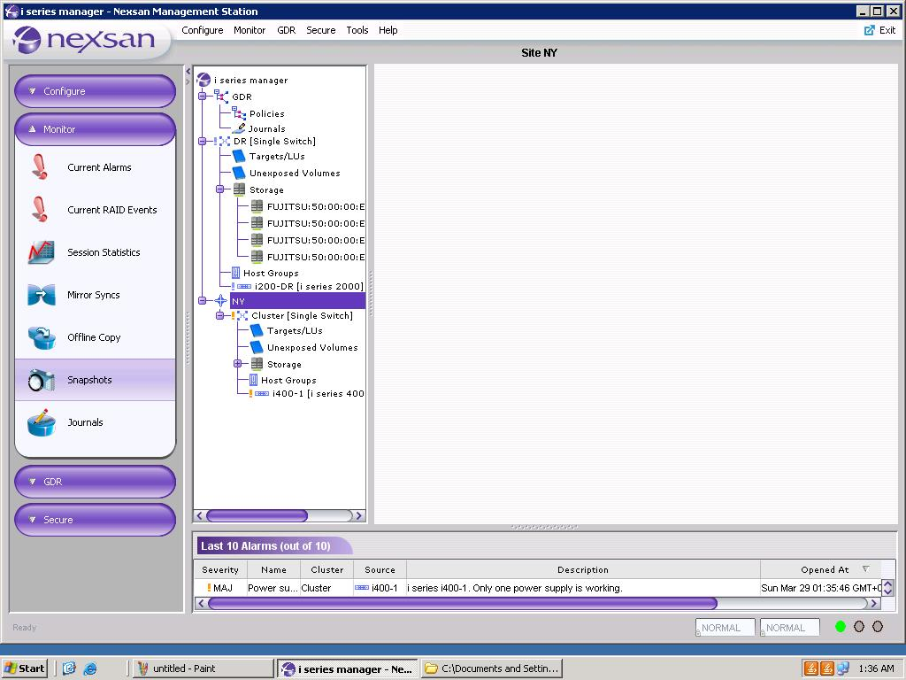
Monitor Snapshot

Slide 7
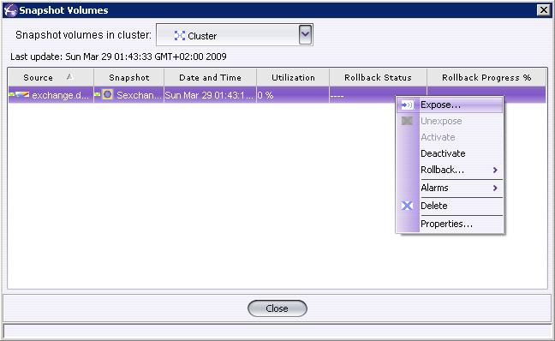
Expose Snapshot

Slide 8
Deactivate Snapshot
(Needed before rollback)

Slide 9
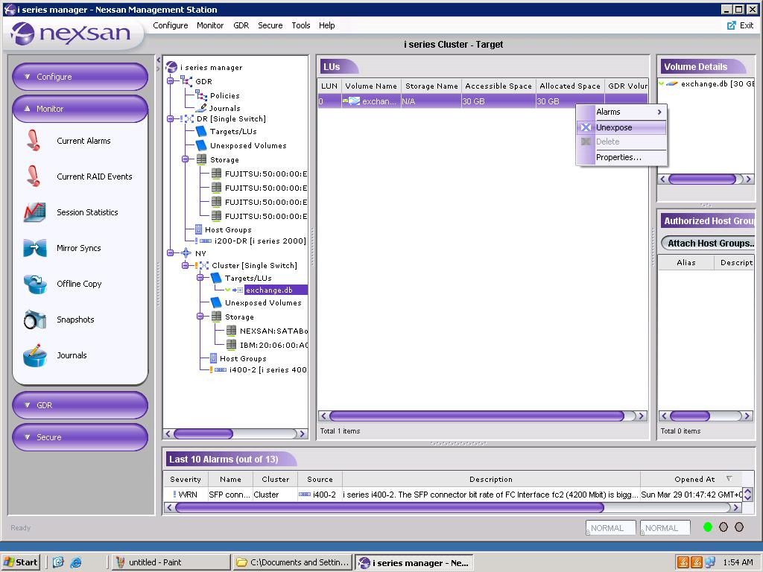
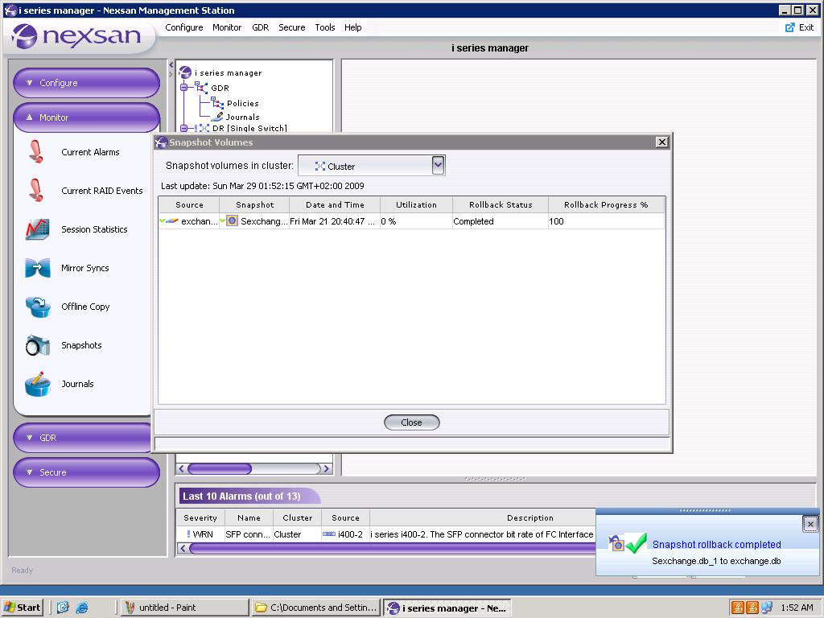
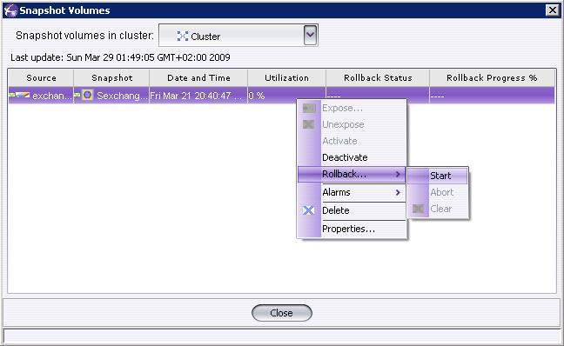
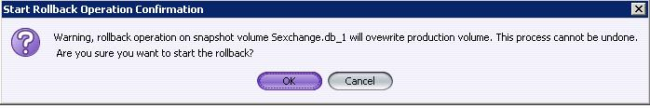
Snapshot Rollback

